Slide 1
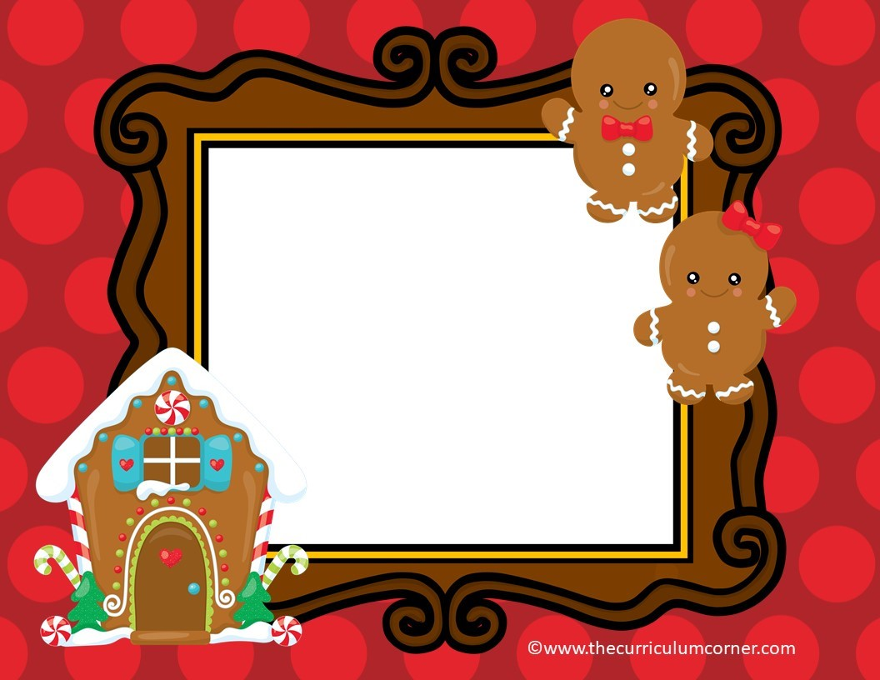
Gingerbread
Numbers
a free PowerPoint
Game from
START HERE
The Curriculum Corner

Slide 2
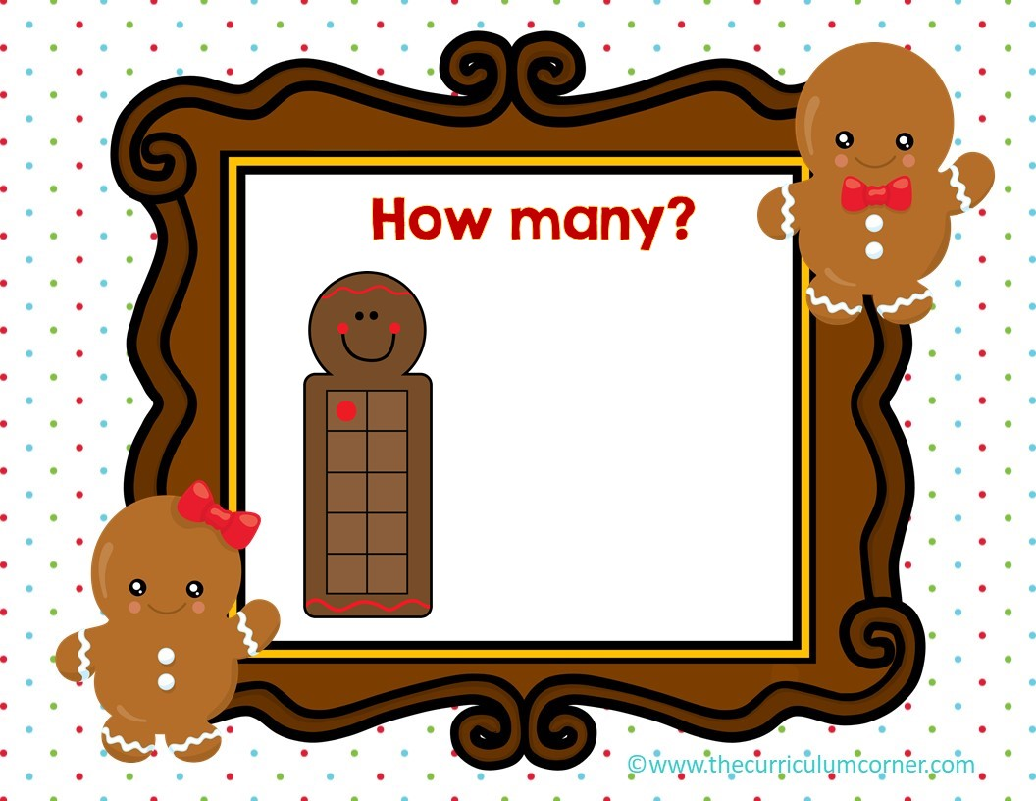
0
1
2

Slide 3

Oops!
click here to try again
©www.thecurriculumcorner.com

Slide 4
WOW!
click here to go to the next

Slide 5

0
1
2

Slide 6
Oops!
click here to try again
©www.thecurriculumcorner.com

Slide 7
WOW!
click here to go to the next

Slide 8
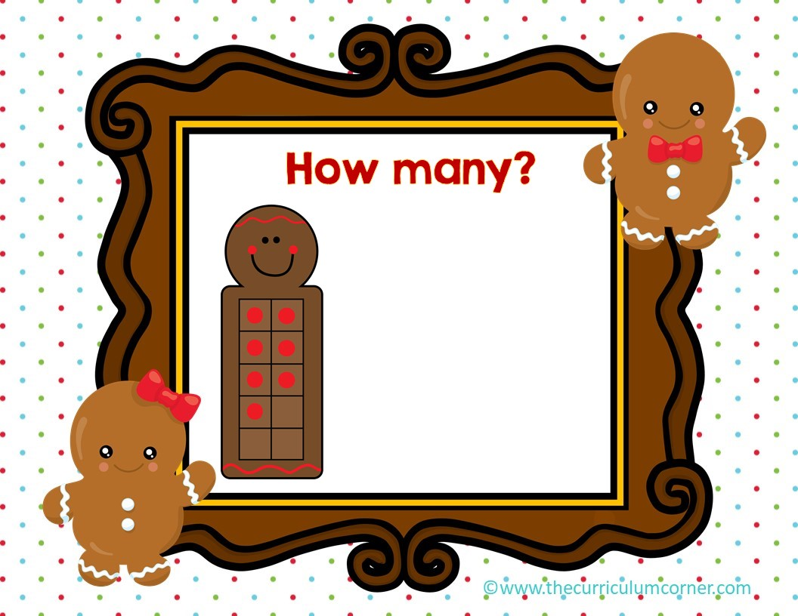
7
8
9

Slide 9
Oops!
click here to try again
©www.thecurriculumcorner.com

Slide 10
WOW!
click here to go to the next

Slide 11
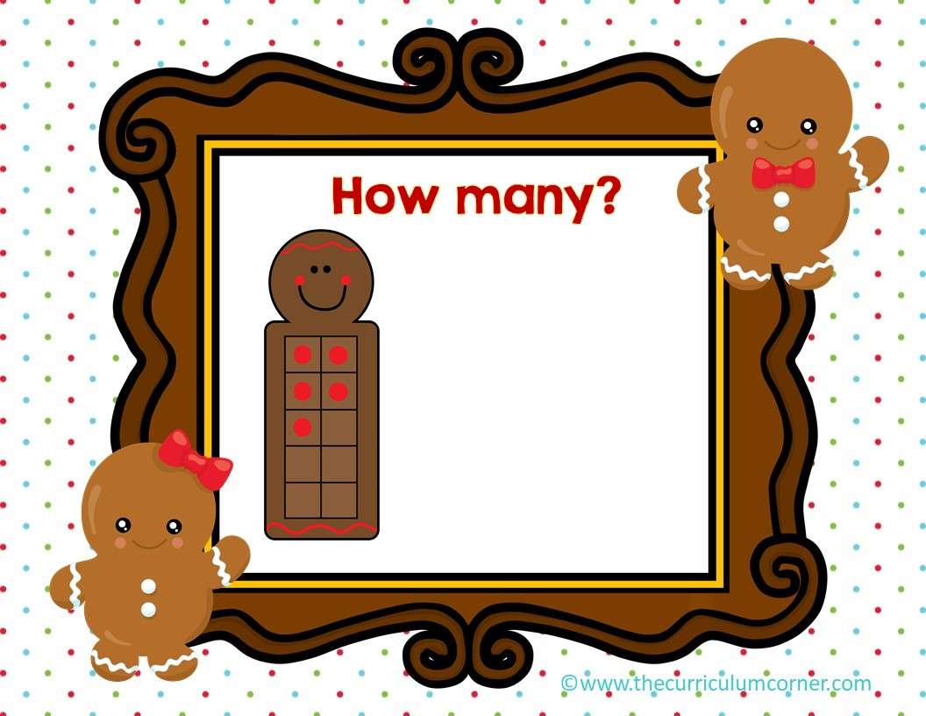
4
5
6

Slide 12
Oops!
click here to try again
©www.thecurriculumcorner.com

Slide 13
WOW!
click here to go to the next

Slide 14
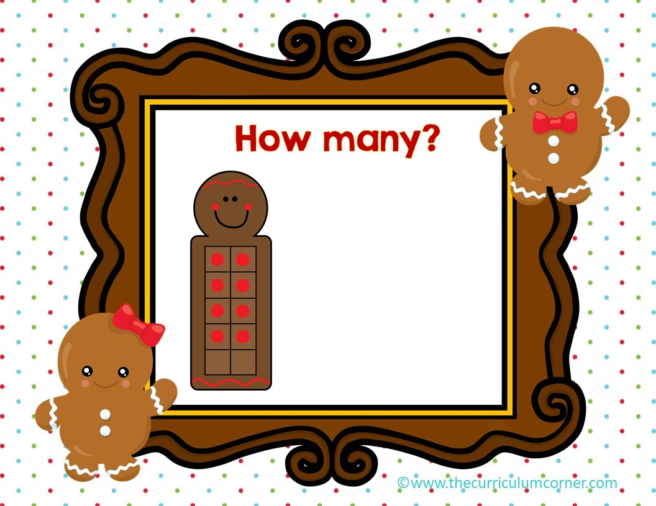
7
8
9

Slide 15
Oops!
click here to try again
©www.thecurriculumcorner.com

Slide 16
WOW!
click here to go to the next

Slide 17
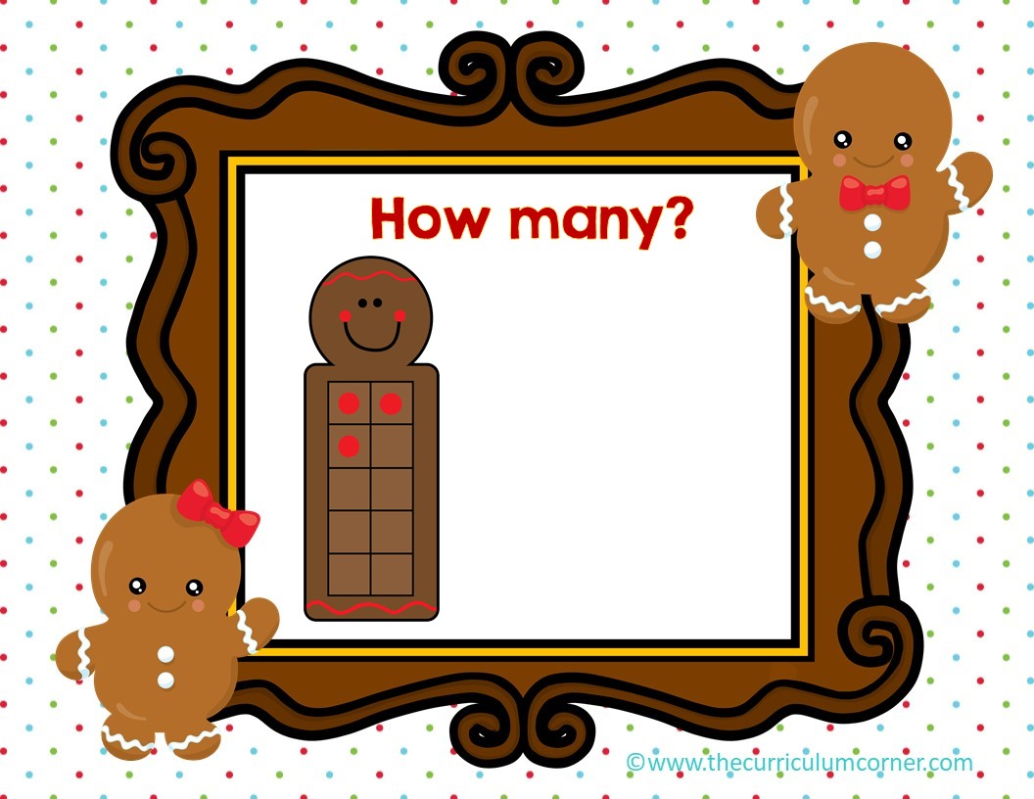
3
4
5

Slide 18
Oops!
click here to try again
©www.thecurriculumcorner.com

Slide 19
WOW!
click here to go to the next

Slide 20

4
5
6

Slide 21
Oops!
click here to try again
©www.thecurriculumcorner.com

Slide 22
WOW!
click here to go to the next

Slide 23
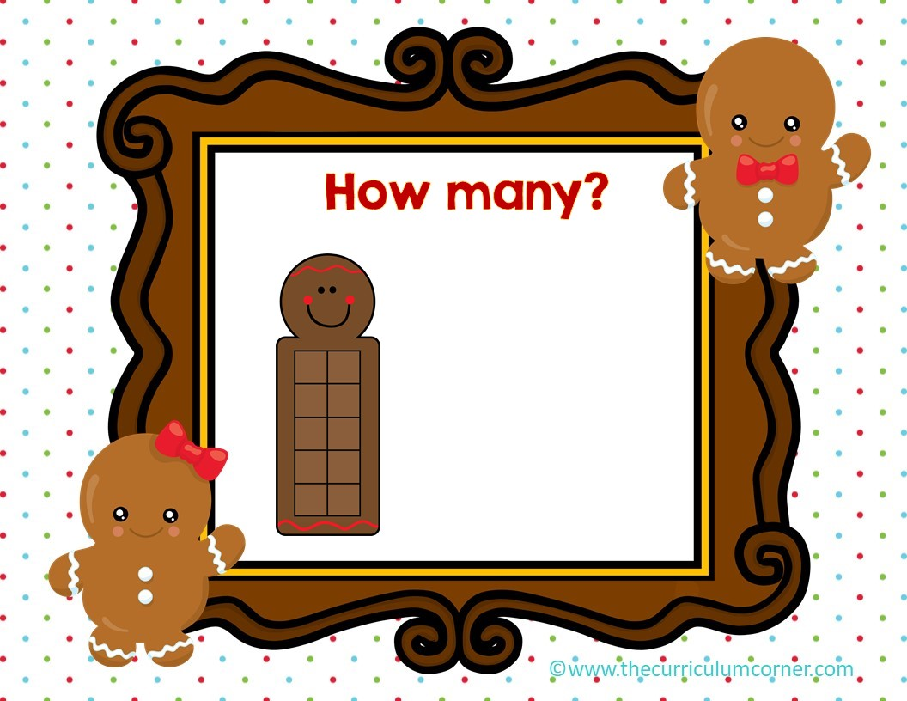
0
1
2

Slide 24
Oops!
click here to try again
©www.thecurriculumcorner.com

Slide 25
WOW!
click here to go to the next

Slide 26
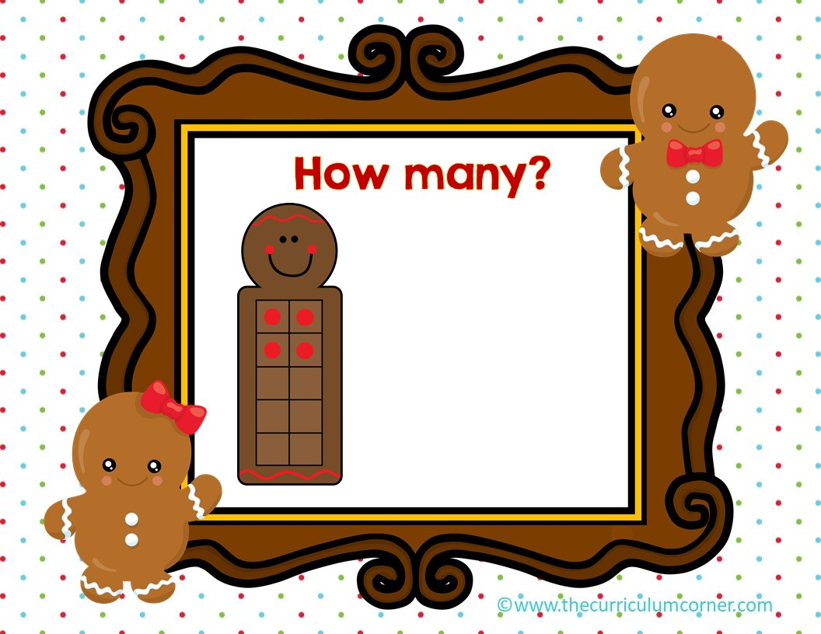
4
5
6

Slide 27
Oops!
click here to try again
©www.thecurriculumcorner.com

Slide 28
WOW!
click here to go to the next

Slide 29

7
8
9

Slide 30
Oops!
click here to try again
©www.thecurriculumcorner.com

Slide 31
WOW!
click here to go to the next

Slide 32

8
9
10

Slide 33
Oops!
click here to try again
©www.thecurriculumcorner.com

Slide 34
WOW!
click here to go to the next

