Slide 1

Gingerbread
Shapes
a free PowerPoint
Game from
START HERE
The Curriculum Corner

Slide 2
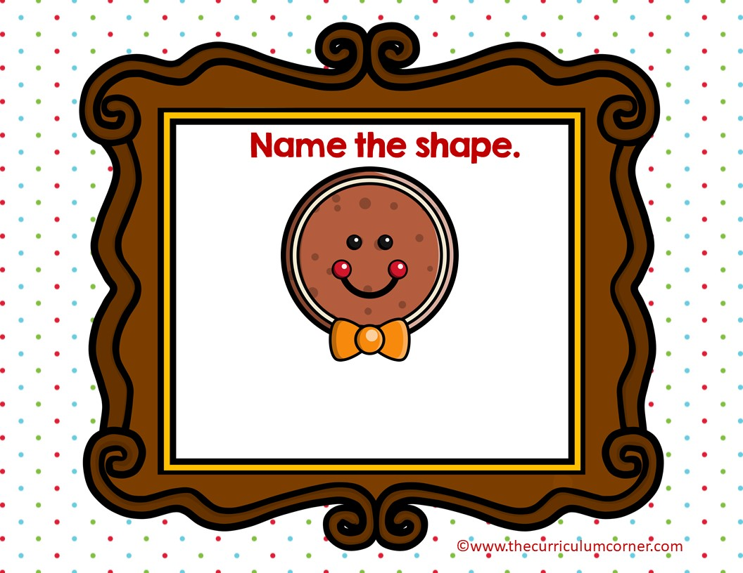
circle
square

Slide 3

Oops!
click here to try again
©www.thecurriculumcorner.com
©www.thecurriculumcorner.com

Slide 4
WOW!
click here to go to the next
©www.thecurriculumcorner.com
©www.thecurriculumcorner.com

Slide 5
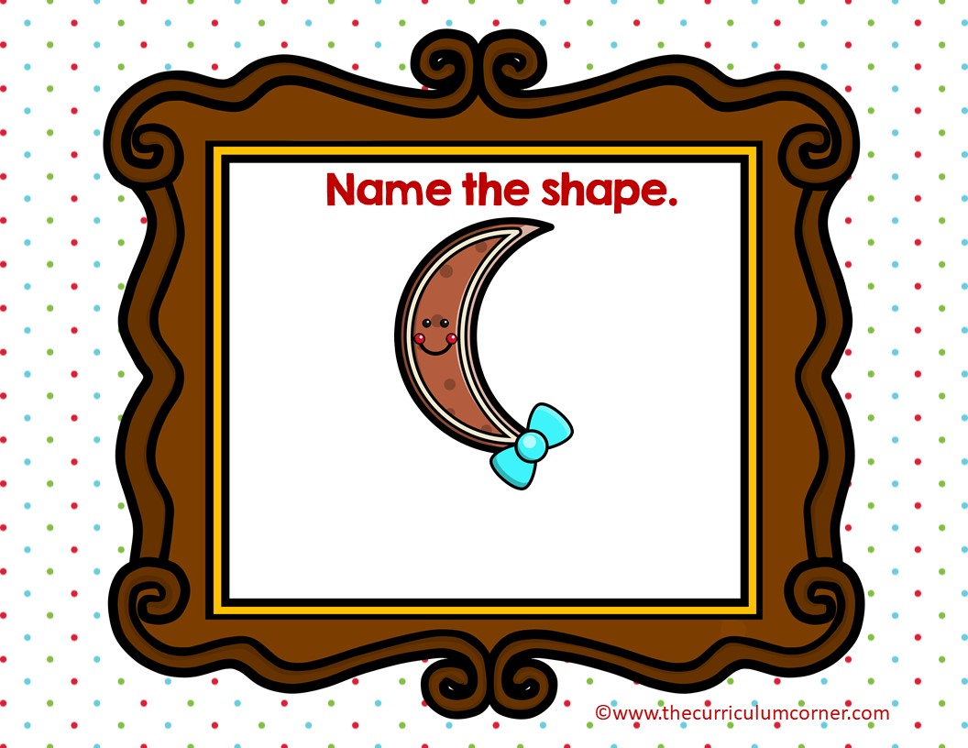
circle
crescent

Slide 6
Oops!
click here to try again
©www.thecurriculumcorner.com
©www.thecurriculumcorner.com

Slide 7
WOW!
click here to go to the next
©www.thecurriculumcorner.com
©www.thecurriculumcorner.com

Slide 8

heart
square

Slide 9
Oops!
click here to try again
©www.thecurriculumcorner.com
©www.thecurriculumcorner.com

Slide 10
WOW!
click here to go to the next
©www.thecurriculumcorner.com
©www.thecurriculumcorner.com

Slide 11
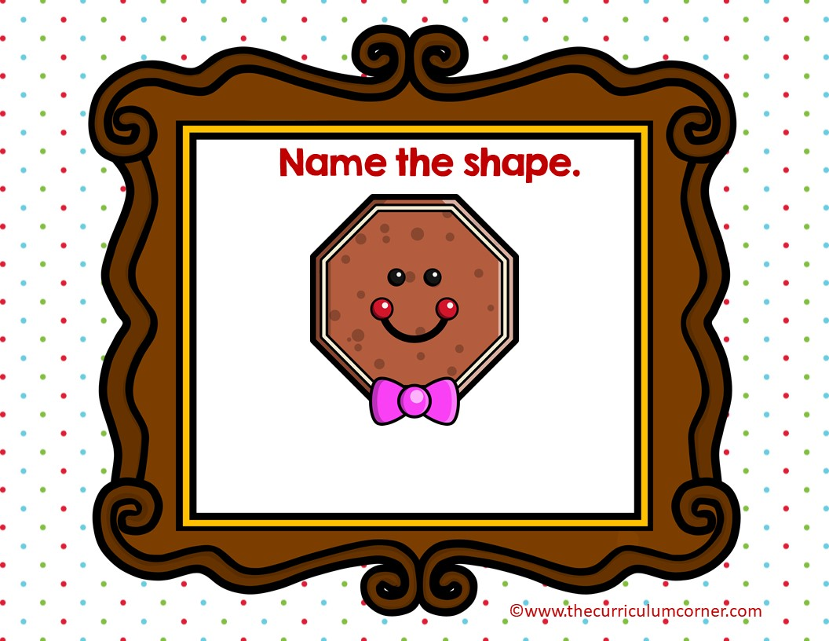
octagon
circle

Slide 12
Oops!
click here to try again
©www.thecurriculumcorner.com
©www.thecurriculumcorner.com

Slide 13
WOW!
click here to go to the next
©www.thecurriculumcorner.com
©www.thecurriculumcorner.com

Slide 14
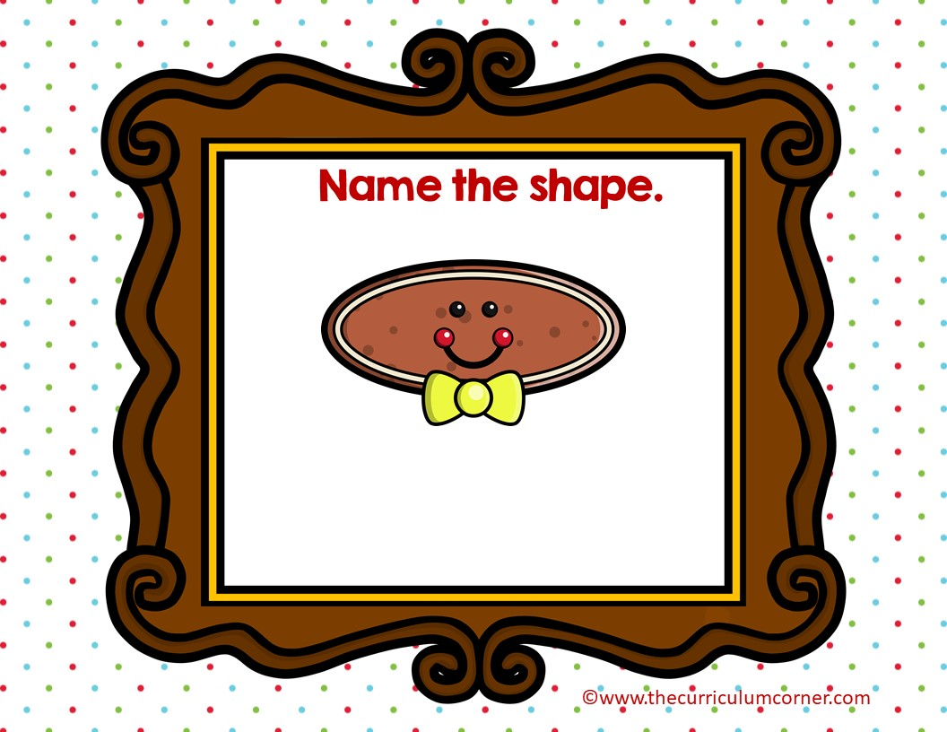
circle
oval

Slide 15
Oops!
click here to try again
©www.thecurriculumcorner.com
©www.thecurriculumcorner.com

Slide 16
WOW!
click here to go to the next
©www.thecurriculumcorner.com
©www.thecurriculumcorner.com

Slide 17
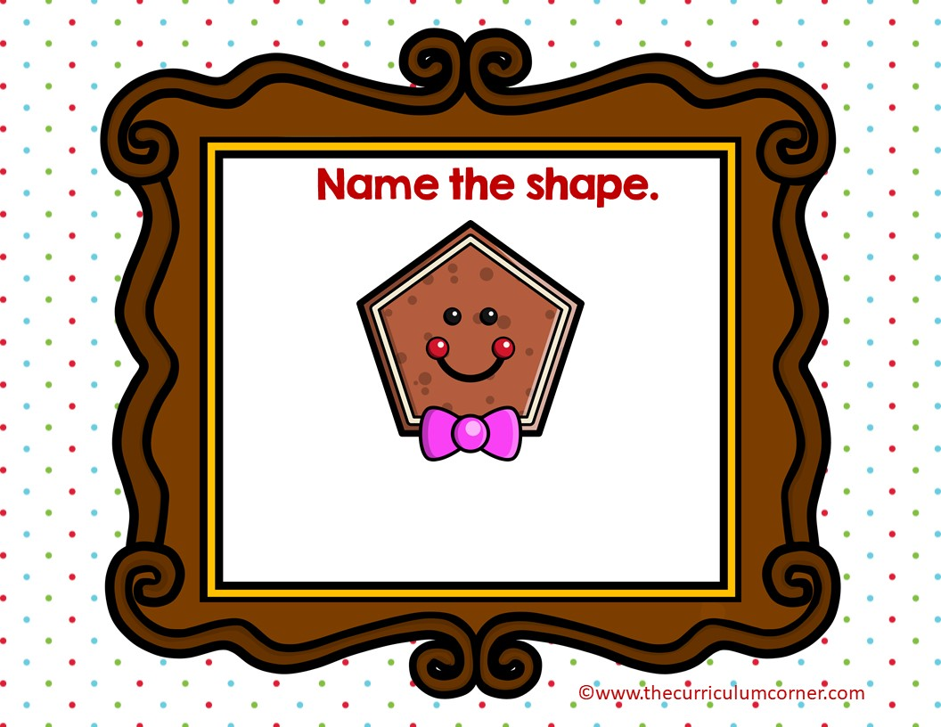
circle
pentagon

Slide 18
Oops!
click here to try again
©www.thecurriculumcorner.com
©www.thecurriculumcorner.com

Slide 19
WOW!
click here to go to the next
©www.thecurriculumcorner.com
©www.thecurriculumcorner.com

Slide 20
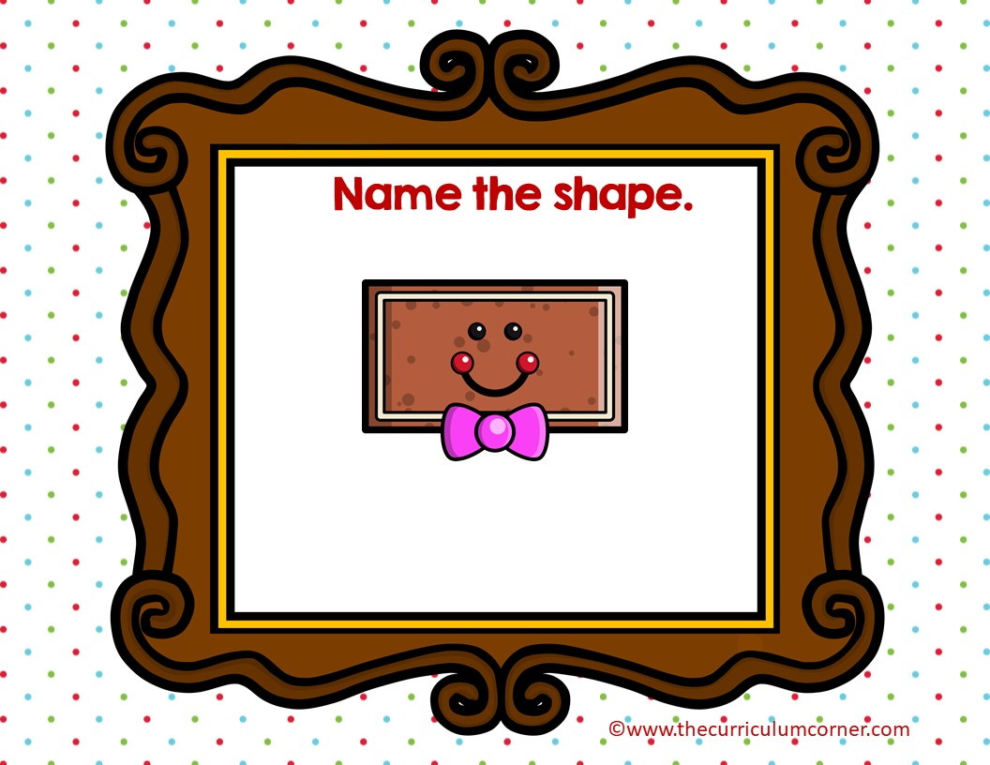
rectangle
square

Slide 21
Oops!
click here to try again
©www.thecurriculumcorner.com
©www.thecurriculumcorner.com

Slide 22
WOW!
click here to go to the next
©www.thecurriculumcorner.com
©www.thecurriculumcorner.com

Slide 23
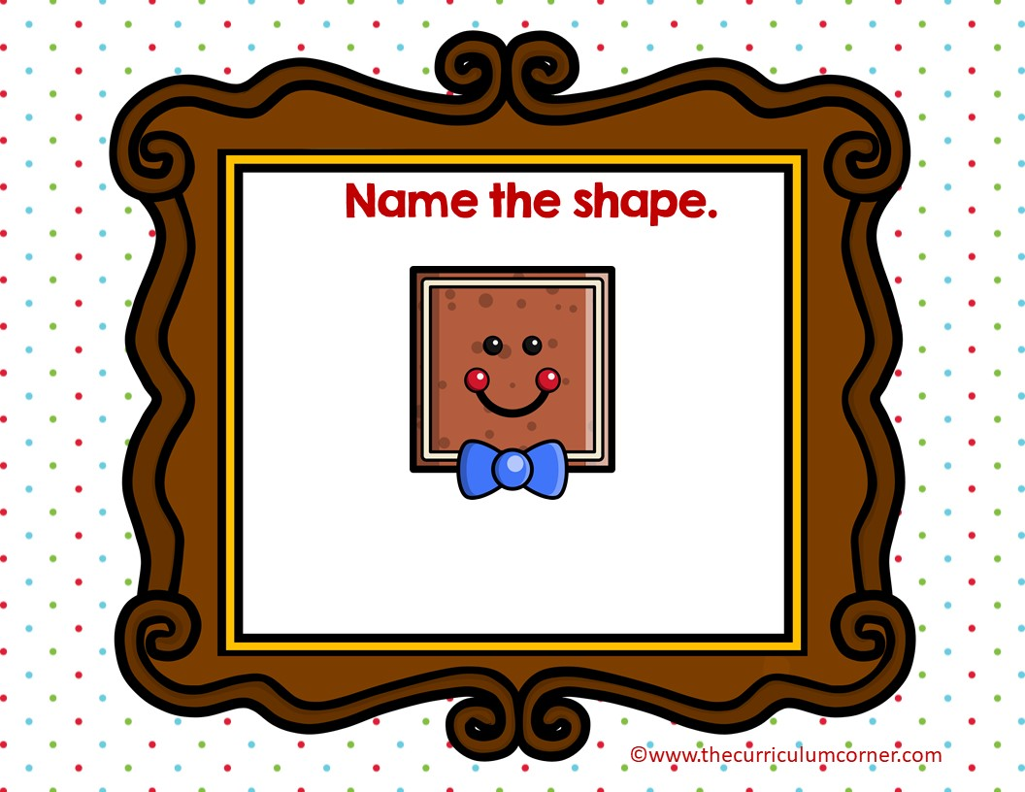
circle
square

Slide 24
Oops!
click here to try again
©www.thecurriculumcorner.com
©www.thecurriculumcorner.com

Slide 25
WOW!
click here to go to the next
©www.thecurriculumcorner.com
©www.thecurriculumcorner.com

Slide 26
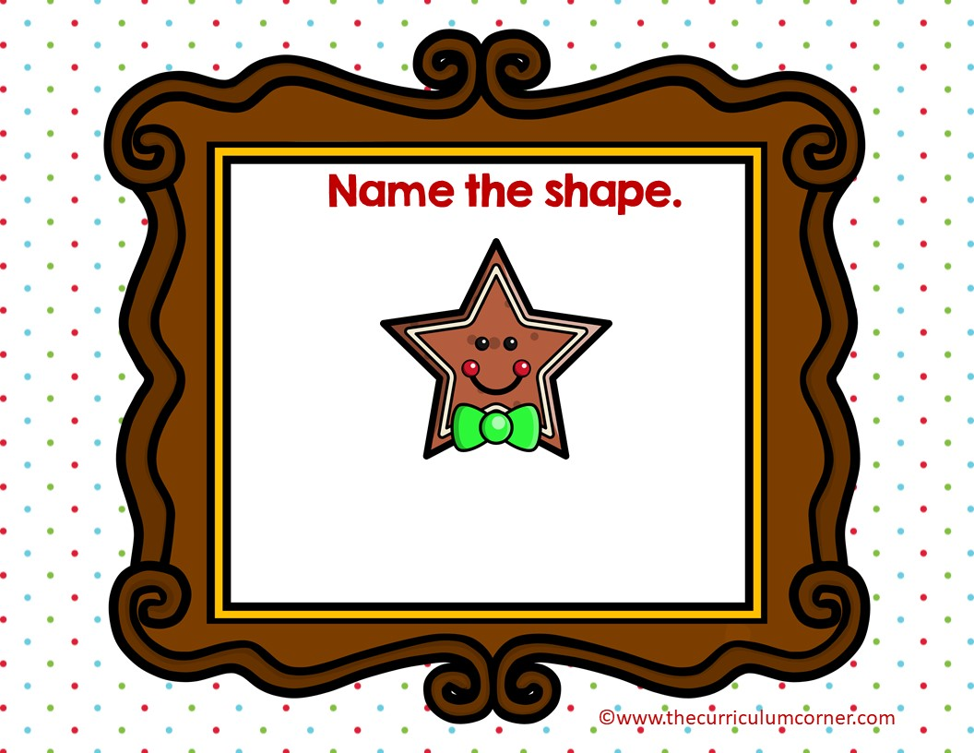
circle
star

Slide 27
Oops!
click here to try again
©www.thecurriculumcorner.com
©www.thecurriculumcorner.com

Slide 28
WOW!
click here to go to the next
©www.thecurriculumcorner.com
©www.thecurriculumcorner.com

Slide 29
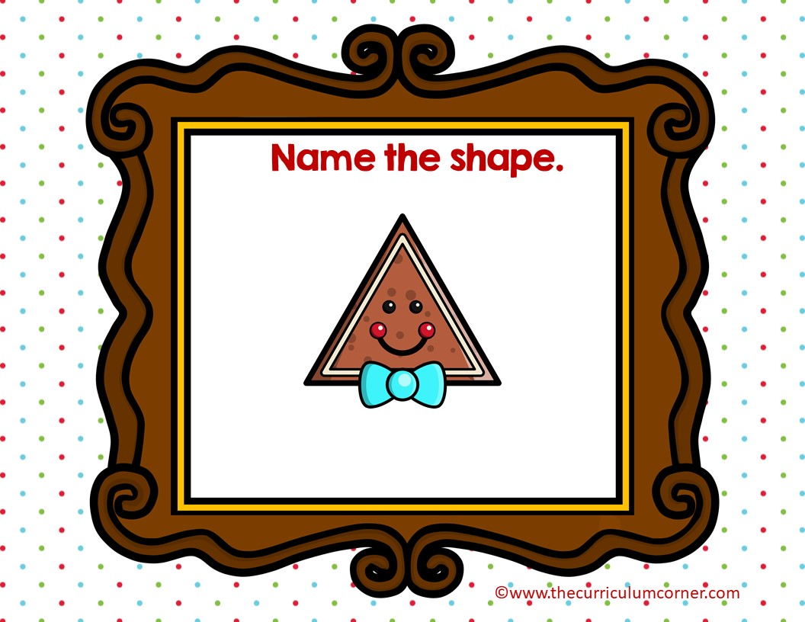
triangle
square

Slide 30
Oops!
click here to try again
©www.thecurriculumcorner.com
©www.thecurriculumcorner.com

Slide 31
WOW!
click here to go to the start
©www.thecurriculumcorner.com
©www.thecurriculumcorner.com

